Slide 1
Statistics for
Data Science
by Pankaj - Royal iLearning

Slide 2
TOC
  Types of Data
  Mean, Median, Mode
  Using mean, median, and mode in Python/R
  Variation and Standard Deviation
  Probability Density Function; Probability Mass Function
  Common Data Distributions
  Percentiles and Moments
  Covariance and Correlation
  Conditional Probability
  Bayes’ Theorem

Slide 3
TOC
  Types of Data
  Mean, Median, Mode
  Using mean, median, and mode in Python/R
  Variation and Standard Deviation
  Probability Density Function; Probability Mass Function
  Common Data Distributions
  Percentiles and Moments
  Covariance and Correlation
  Conditional Probability
  Bayes’ Theorem
Notes:
big data, you typically have the four Vs – volume, veracity, velocity, and variety.
Another V exists that is important for your data – validity.

Slide 4
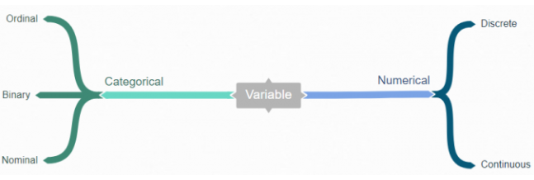
Types of Data
Numerical
Categorical

Slide 5
Numerical
Numerical data is information that is measurable, and it is, of course, data represented as numbers and not words or text.
Continuous numbers are numbers that don’t have a logical end to them.
Examples - variables that represent money or height.
Discrete numbers are the opposite; they have a logical end to them.
Example - variables for days in the month, or number of bugs logged.
Notes:
1. Ordinal values include having a priority on a bug such as “Critical” or “Low” or the ranking of a race as “First” or “Third”
2. Nominal value examples include variables such as “Country” or “Marital Status”.
3. Can be represented in different ways such as “True” and “False” or 1 and 0.

Slide 6
Categorical
Categorical data, this is any data that isn’t a number, which can mean a string of text or date.
Ordinal values are values that have a set order to them. Example – Ranking of race “First” or “Third”.
Nominal values are the opposite of ordinal values, and they represent values with no set order to them. Example - variables such as “Country” or “Marital Status”.
Binary data types only have two values – yes or no. Example - “True” and “False” or 1 and 0
Notes:
1. Ordinal values include having a priority on a bug such as “Critical” or “Low” or the ranking of a race as “First” or “Third”
2. Nominal value examples include variables such as “Country” or “Marital Status”.
3. Can be represented in different ways such as “True” and “False” or 1 and 0.

Slide 7
TOC
  Types of Data
  Mean, Median, Mode
  Using mean, median, and mode in Python/R
  Variation and Standard Deviation
  Probability Density Function; Probability Mass Function
  Common Data Distributions
  Percentiles and Moments
  Covariance and Correlation
  Conditional Probability
  Bayes’ Theorem

Slide 8
Mean, Median, Mode
The measures of central tendencies such as mean, median and mode are measures that gives us some idea about the of centrality of data.
Mean or average is the value obtained by dividing the sum of all the data by the total number of data points.
Median the data situated at the middle position of the set. In a set with odd number of data points the median is the middlemost value while if the number of data points is even then it is the average of the two middle items.
Mode refers the data item that occurs most frequently in a given data set.

Slide 9
Mean, Median, Mode
Example: Data Set - 55, 56, 56, 58, 60, 61, 63, 64, 70, 78
Mean = (55 + 56 + 56 + 58 + 60 + 61 + 63 + 64 + 70 + 78) / 10 = 62.1
Median = (60 + 61)/2 = 60.5
Mode = 56

Slide 10
TOC
  Types of Data
  Mean, Median, Mode
  Using mean, median, and mode in Python/R
  Variation and Standard Deviation
  Probability Density Function; Probability Mass Function
  Common Data Distributions
  Percentiles and Moments
  Covariance and Correlation
  Conditional Probability
  Bayes’ Theorem

Slide 11
TOC
  Types of Data
  Mean, Median, Mode
  Using mean, median, and mode in Python/R
  Variation and Standard Deviation
  Probability Density Function; Probability Mass Function
  Common Data Distributions
  Percentiles and Moments
  Covariance and Correlation
  Conditional Probability
  Bayes’ Theorem

Slide 12

Variation and Standard Deviation
Variance signifies how much the data items are deviating from mean.
Mathematical Formulae
:
Larger variance means the data items deviate more from the mean.
Smaller variance means the data items are closer to the mean.

Slide 13
Variation and Standard Deviation
Standard Deviation is simply the square root of the variance. In the above formula, σ is the standard deviation and σ2 is the variance.

Slide 14
TOC
  Types of Data
  Mean, Median, Mode
  Using mean, median, and mode in Python/R
  Variation and Standard Deviation
  Probability Density Function; Probability Mass Function
  Common Data Distributions
  Percentiles and Moments
  Covariance and Correlation
  Conditional Probability
  Bayes’ Theorem

Slide 15
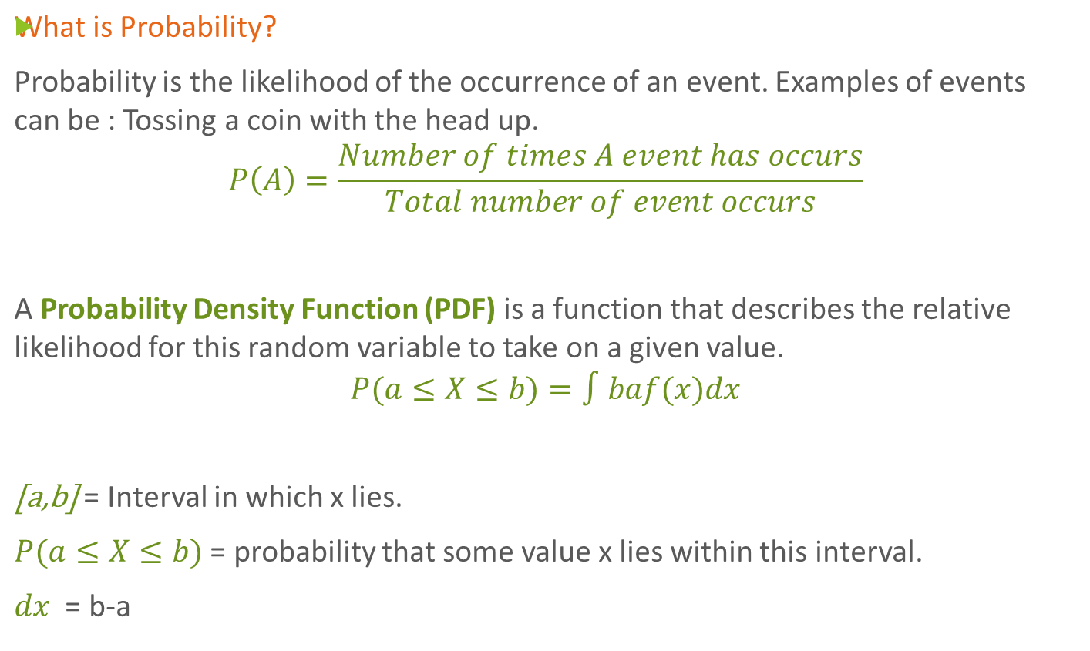
Probability Density Function; Probability Mass Function
Notes:
During the day, a clock at random stops once at any time.
If x be the time when it stops and the PDF for x is given by:
Calculate the probability that clock stops between 2 pm and 2:45 pm.
f(x)={1/24,0,for 0≤x≤24 | 0otherwise
P(14≤X≤14.45)=∫14.4514f(x)dx =124(14.45−14) =124(0.45) =0.01875

Slide 16
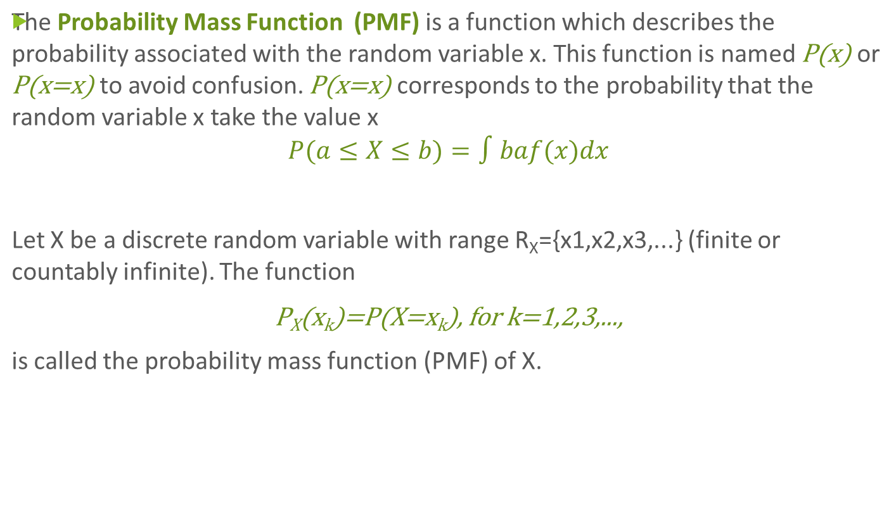
Probability Density Function; Probability Mass Function
Notes:
Let’s roll a die an infinite number of times and look at the proportion of 1, the proportion of 2 and so on. We call xx the random variable that corresponds to the outcome of the dice roll. Thus the random variable xx can only take the following discrete values: 1, 2, 3, 4, 5 or 6. It is thus a discrete random variable.
The aim of the probability mass function is to describe the probability of each possible value. In our example, it describes the probability to get a 1, the probability to get a 2 and so on. In the case of a dice rolling experiment, we have the same probability to get each value (if we assume that the die is perfect). This means that we can write:
P(x=1)=P(x=2)=P(x=3)=P(x=4)=P(x=5)=P(x=6) = 1/6.

Slide 17
TOC
  Types of Data
  Mean, Median, Mode
  Using mean, median, and mode in Python/R
  Variation and Standard Deviation
  Probability Density Function; Probability Mass Function
  Common Data Distributions
  Percentiles and Moments
  Covariance and Correlation
  Conditional Probability
  Bayes’ Theorem

Slide 18
Common Data Distribution
There are 5 Common data distribution:
  Bernoulli Distribution
  Uniform Distribution
  Normal Distribution
  Poisson Distribution
  Exponential Distribution
Notes:
E(X) = 1*p + 0*(1-p) = p
V(X) = E(X²) – [E(X)]² = p – p² = p(1-p)

Slide 19
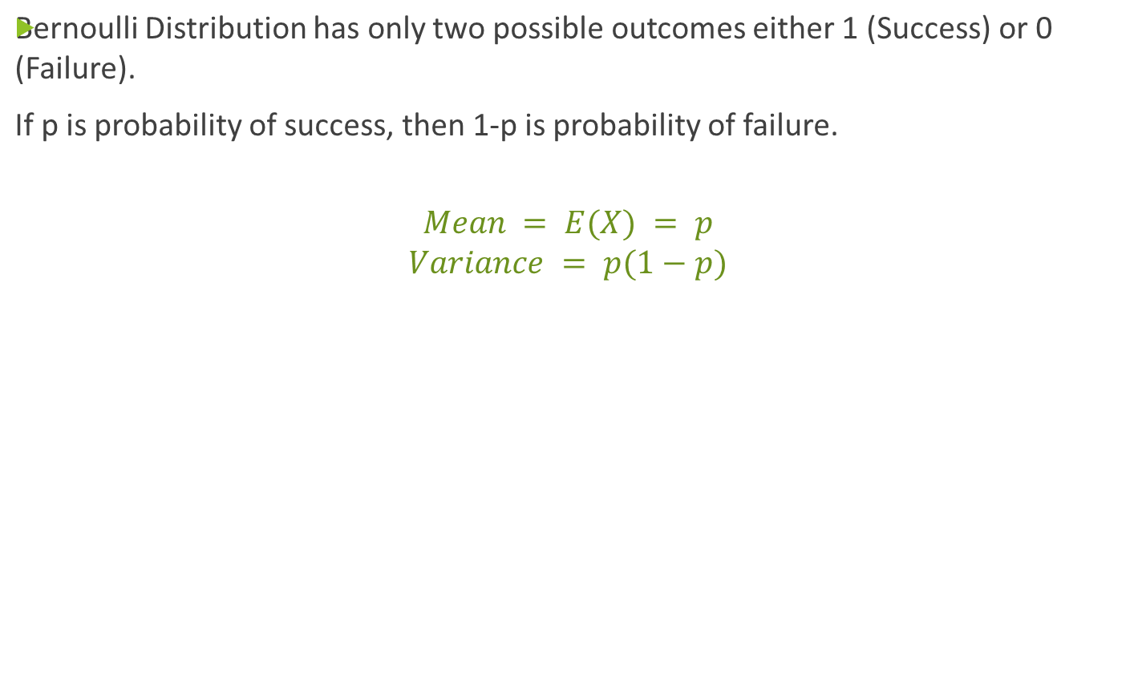
1. Bernoulli Distribution
Notes:
E(X) = 1*p + 0*(1-p) = p
V(X) = E(X²) – [E(X)]² = p – p² = p(1-p)

Slide 20
2. Uniform Distribution
Uniform Distribution is in which all outcomes are equally likely; each variable has the same probability that it will be the outcome
Example – Flipping of coin.
Notes:
E(X) = 1*p + 0*(1-p) = p
V(X) = E(X²) – [E(X)]² = p – p² = p(1-p)

Slide 21
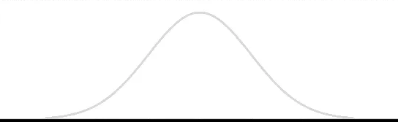
4. Normal Distribution
A standard normal distribution is defined as the distribution with mean 0 and standard deviation 1.
Notes:
E(X) = 1*p + 0*(1-p) = p
V(X) = E(X²) – [E(X)]² = p – p² = p(1-p)

Slide 22

5. Poisson Distribution
Poisson Distribution is applicable in situations where events occur at random points of time and space wherein our interest lies only in the number of occurrences of the event.
Notes:
E(X) = 1*p + 0*(1-p) = p
V(X) = E(X²) – [E(X)]² = p – p² = p(1-p)

Slide 23
6. Exponential Distribution
Exponential distribution is widely used for survival analysis. From the expected life of a machine to the expected life of a human, exponential distribution successfully delivers the result.
f(x) = { λe - λx, x ≥ 0
Notes:
E(X) = 1*p + 0*(1-p) = p
V(X) = E(X²) – [E(X)]² = p – p² = p(1-p)

Slide 24
TOC
  Types of Data
  Mean, Median, Mode
  Using mean, median, and mode in Python/R
  Variation and Standard Deviation
  Probability Density Function; Probability Mass Function
  Common Data Distributions
  Percentiles and Moments
  Covariance and Correlation
  Conditional Probability
  Bayes’ Theorem

Slide 25
Percentiles and Moments
When a value is given x percentile, this means that x percentage of values in the distribution is below that value.
Moments try to measure the shape of the probability distribution function. The zeroth moment is the total probability of the distribution which is 1.
  The first moment is the mean.
  The second moment is the variance.
  The third moment is the skew which measures how lopsided the distribution is.
  The fourth moment is kurtosis which is the measure of how sharp is the peak of the graph.

Slide 26
TOC
  Types of Data
  Mean, Median, Mode
  Using mean, median, and mode in Python/R
  Variation and Standard Deviation
  Probability Density Function; Probability Mass Function
  Common Data Distributions
  Percentiles and Moments
  Covariance and Correlation
  Conditional Probability
  Bayes’ Theorem

Slide 27

Covariance and Correlation
Covariance measures how two variables vary in tandem to their means. The formula to calculate covariance is shown below.
where x and y are the individual values of X and Y ranging from i = 1,2, .., n where the probability that each value may occur is equal and is equal to (1/n). E(x) and E(y) are the means of X and Y.

Slide 28

Covariance and Correlation
Correlation also measures how two variables move with respect to each other.
A perfect positive correlation means that the correlation coefficient is 1.
A perfect negative correlation means that the correlation coefficient is -1.
A correlation coefficient of 0 means that the two variables are independent of each other.
The formula for finding the correlation coefficient can be found using the following formula.

Slide 29
TOC
  Types of Data
  Mean, Median, Mode
  Using mean, median, and mode in Python/R
  Variation and Standard Deviation
  Probability Density Function; Probability Mass Function
  Common Data Distributions
  Percentiles and Moments
  Covariance and Correlation
  Conditional Probability
  Bayes’ Theorem

Slide 30
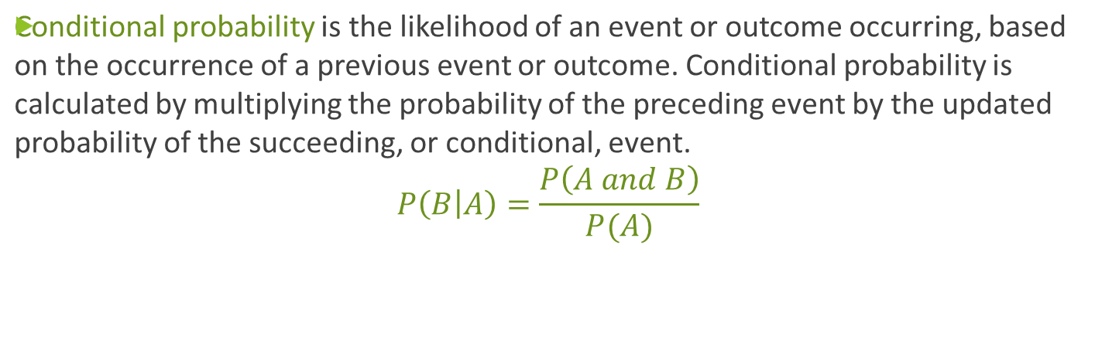
Conditional Probability
Notes:
suppose you are drawing three marbles—red, blue and green—from a bag.
Each marble has an equal chance of being drawn. What is the conditional probability of drawing the red marble after already drawing the blue one? First, the probability of drawing a blue marble is about 33% because it is one possible outcome out of three. Assuming this first event occurs, there will be two marbles remaining, with each having a 50% of being drawn. So, the chance of drawing a blue marble after already drawing a red marble would be about 16.5% (33% x 50%).

Slide 31
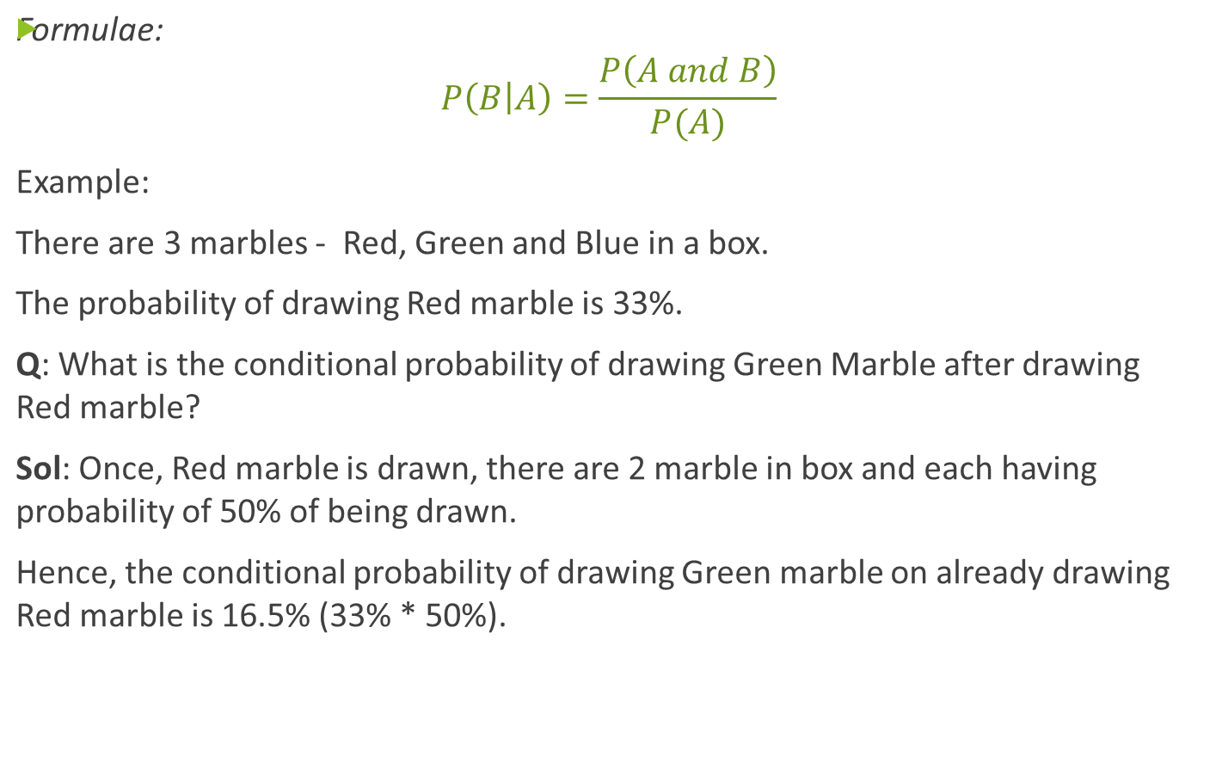
Conditional Probability
Notes:
suppose you are drawing three marbles—red, blue and green—from a bag. Each marble has an equal chance of being drawn. What is the conditional probability of drawing the red marble after already drawing the blue one? First, the probability of drawing a blue marble is about 33% because it is one possible outcome out of three. Assuming this first event occurs, there will be two marbles remaining, with each having a 50% of being drawn. So, the chance of drawing a blue marble after already drawing a red marble would be about 16.5% (33% x 50%).

Slide 32
TOC
  Types of Data
  Mean, Median, Mode
  Using mean, median, and mode in Python/R
  Variation and Standard Deviation
  Probability Density Function; Probability Mass Function
  Common Data Distributions
  Percentiles and Moments
  Covariance and Correlation
  Conditional Probability
  Bayes’ Theorem

Slide 33
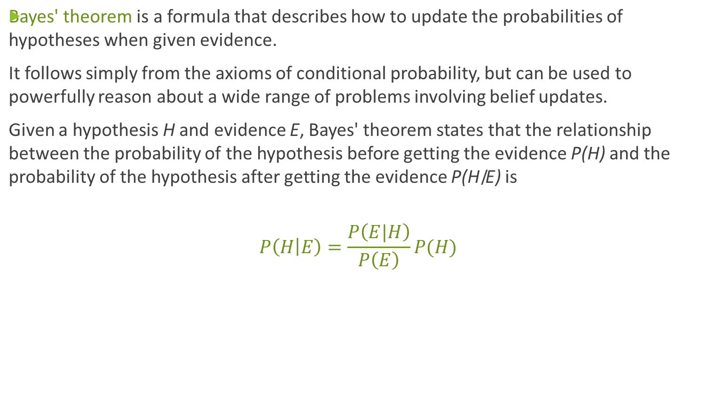
Bayes’ Theorem

